Slide 1
Stock Exchange Data
Analysis and Insights

Slide 2
Agenda
Introduction
Overview of the stock exchange and its importance.
Purpose and scope of the analysis.
Objectives
Main goals (e.g., market trend analysis, stock price prediction, volatility assessment).
Data Collection
Data sources (e.g., historical stock prices, trading volumes, financial statements).
Time period and scope of the data.
Data Cleaning and Preparation
Data preprocessing steps (e.g., handling missing values, data normalization).
Tools and techniques used (e.g., Python, R).

Slide 3
Introduction/Objective
Introduction
The stock exchange is a crucial component of the global financial market, providing a platform for buying and selling securities such as stocks and bonds. Understanding stock exchange data is essential for investors, analysts, and policymakers to make informed decisions.
Objective
The objective of this presentation is to analyze stock exchange data to uncover trends, patterns, and insights that can inform investment strategies and market predictions. This analysis will involve data collection, cleaning, feature engineering, exploratory data analysis (EDA), and the creation of calculated columns to derive meaningful insights.

Slide 4
Dataset Description
Index Data
Description: This dataset contains raw stock exchange data, including daily prices, trading volumes, and other relevant metrics for various stocks.
Index Info
Description: This dataset provides metadata about the stocks included in the index Data, such as company names, sectors, and market capitalization.
indexProcessed
Description: This dataset is the result of data cleaning and feature engineering applied to the raw data in indexData. It includes additional calculated columns and transformed variables for analysis.

Slide 5
Methodology
Feature Engineering: Create new features from the raw data, such as moving averages, volatility indices, and daily returns.
Normalization/Standardization: Scale the data to ensure that all features contribute equally to the analysis.
Descriptive Statistics: Use summary statistics to provide an overview of the data.
Charts and Graphs: Create visualizations such as line charts for stock prices, bar charts for trading volumes, and scatter plots for correlations.

Slide 6
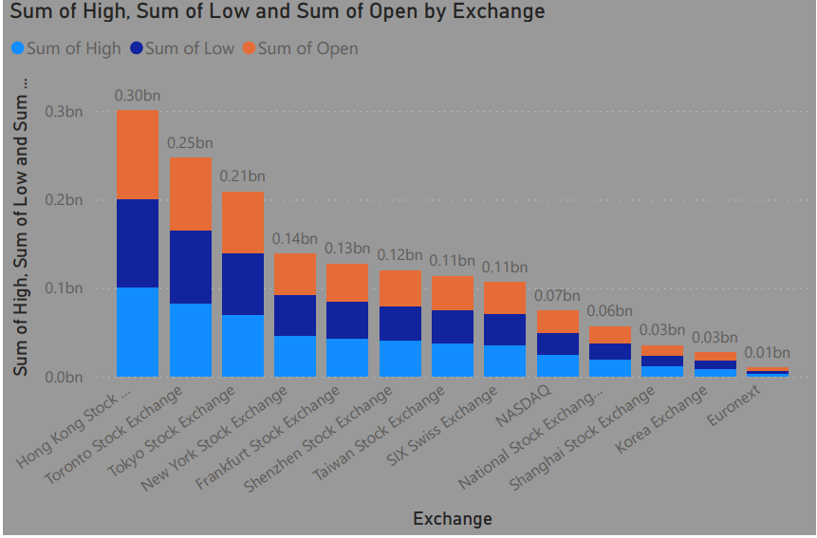
Key Visuals and Insights
The Open High Low (OHL) strategy is a popular technique traders use in the stock market. It's a simple yet effective approach where a buying signal is generated when a stock's open price is the same as its low price. Conversely, a selling signal is generated when the open price is the same as the high price. The goal is to identify trends and patterns in the stock market and make trading decisions accordingly

Slide 7
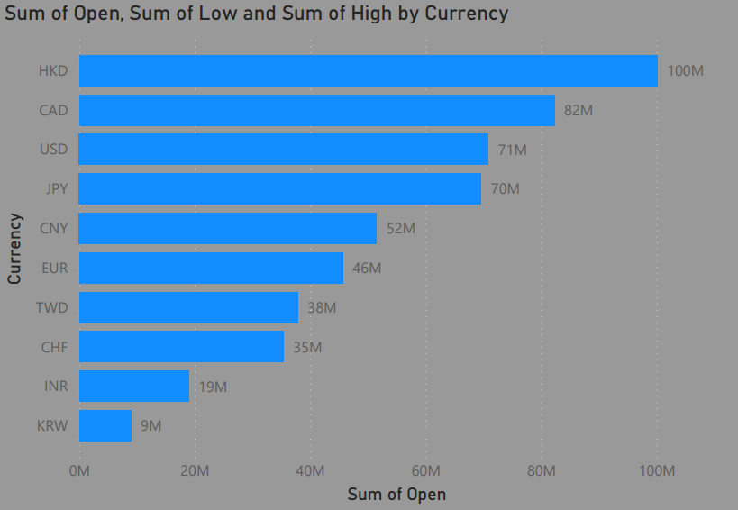
Sum of Currency
The OHL trading strategy is an intraday trading strategy for stocks where the configuration of open, high, and low price levels in the first few minutes of the session is used to determine trade entry. A buy signal is generated when the open price is the same as the low price for the day, while a sell signal is generated when the open price is the same as the high price for the day.

Slide 8
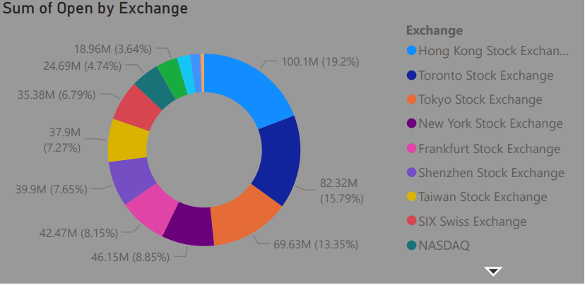
Sum of open for exchange
Dominant Exchanges:
Hong Kong Stock Exchange leads with a significant share of 19.2%, totaling 100.1M.
Major Contributors:
The top three exchanges (Hong Kong, Toronto, and Tokyo) together account for nearly 50% of the total sum of open prices.
Mid-Tier Exchanges:
New York Stock Exchange (8.85% - 46.15M) and Frankfurt Stock Exchang(11.65% - 42.47M) are also notable contributors.
Market Strategy: Companies and investors may focus on the top-performing exchanges for maximum exposure and liquidity.

Slide 9
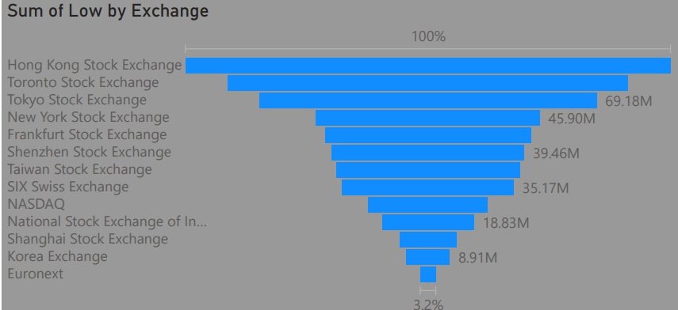
Sum of Low by exchange
The bar chart you shared, titled “Sum of Low by Exchange,” illustrates the sum of low trading values across various global stock exchanges. Here are the key points:
Hong Kong Stock Exchange: 100%
Toronto Stock Exchange: 69.18M
Tokyo Stock Exchange: 45.90M
New York Stock Exchange: 39.46M
This chart provides a clear visual comparison of the sum of low values across these exchanges, with the Hong Kong Stock Exchange leading significantly.

Slide 10
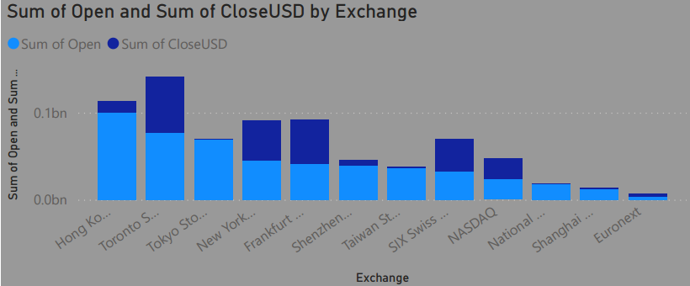
Sum of closeUSD by exchange
Hong Kong Stock Exchange:
Sum of Open: Highest among all exchanges.
Sum of CloseUSD: Also the highest, indicating strong market activity.
Toronto Stock Exchange:
Sum of Open: High.
Sum of CloseUSD: High, showing consistent performance.
Market Leaders: The Hong Kong Stock Exchange leads in both the sum of open and close values, indicating it has the highest trading volumes and market activity among the listed exchanges.
Comparative Analysis: The chart allows for a quick comparison of market activities across different exchanges, highlighting which ones have higher trading volumes and which are more balanced.

Slide 11
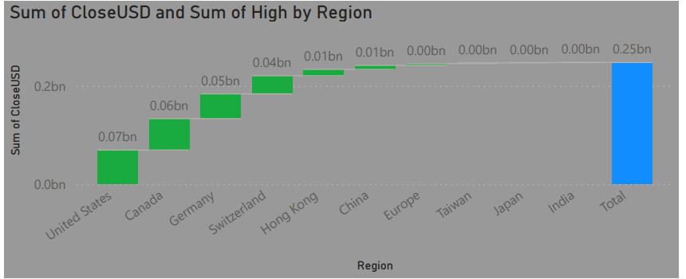
Sum of close Usd by region
Market Leaders: The United States leads in both the sum of close and high values, indicating it has the highest trading volumes and market activity among the listed regions.
Consistent Performers: Regions like Canada and Germany show high and moderate values, respectively, for both close and high sums, suggesting consistent market performance.
Balanced Trading: Most regions, including Switzerland, Hong Kong, and China, show moderate values for both metrics, indicating balanced and steady trading activities.
Comparative Analysis: The chart allows for a quick comparison of market activities across different regions, highlighting which ones have higher trading volumes and which are more balanced.

Slide 12
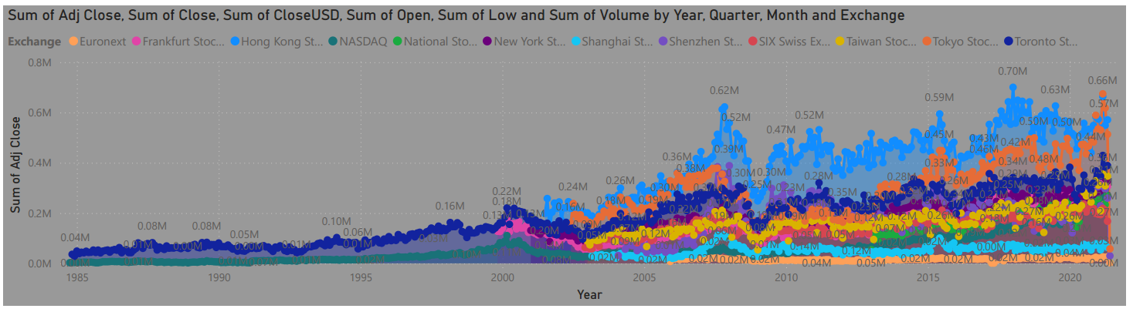
Stock Processed Data
Market Growth:
The chart shows a general upward trend in the sum of Adjusted Close, Close, and CloseUSD values, indicating market growth over the years.
Significant peaks and troughs can be observed, corresponding to major market events or economic cycles.
Exchange Contributions:
Different exchanges contribute variably to the overall sums, with some exchanges showing more significant activity in certain periods.
Volume Fluctuations:
The volume metric highlights periods of high trading activity, which could be linked to market volatility or significant economic events.
Understanding these fluctuations can help in analyzing market behavior and investor sentiment.
Comparative Analysis:
The chart allows for a comparative analysis of different exchanges and their performance over time.
It helps identify which exchanges have been more active or stable in terms of trading volumes and values.

Slide 13
Analysis and Interpretation:
Stock Price Trends
Visual: Line chart showing the daily closing prices of selected stocks over time.
Interpretation: This chart helps identify overall trends, such as upward or downward movements in stock prices.
Trend Identification: Recognizing trends in stock prices and trading volumes can help businesses and investors make timely decisions, such as when to buy or sell stocks.
Risk Management: Understanding volatility and correlations aids in managing risk by diversifying investments and avoiding overexposure to highly volatile stocks.
Performance Evaluation: Analyzing returns and moving averages provides insights into stock performance, helping investors evaluate the effectiveness of their investment strategies and make adjustments as needed.

Slide 14
Future prediction
Economic Indicators
GDP Growth: Strong GDP growth often correlates with rising stock prices as it indicates a healthy economy.
Inflation Rates: Moderate inflation is generally positive for stocks, but high inflation can erode purchasing power and negatively impact stock prices.
Interest Rates: Lower interest rates can boost stock prices by reducing borrowing costs and encouraging investment. Conversely, rising rates can have the opposite effect.

Slide 15
Conclusion
Key Findings
Trend Analysis: The analysis revealed significant trends in stock prices, with certain stocks showing consistent upward or downward movements. These trends can be indicative of the overall market sentiment and company performance.
Recommendations
Invest in High-Growth Sectors: Based on the trend analysis, consider investing in sectors that show consistent growth and strong performance. High-growth sectors often offer better returns but may come with higher risks.
Monitor Volatility: Keep an eye on the volatility indices of stocks. High volatility stocks can offer significant returns but require careful risk management. Diversifying investments can help mitigate these risks.
Evaluate Performance: Continuously evaluate the performance of your investments using metrics like moving averages and returns distribution. Adjust your investment strategy based on these evaluations to optimize returns.

